Slide 1
Optimal management of CNS metastases in patients with a targetable mutation
Gregory J. Riely
March 3, 2018

Slide 2
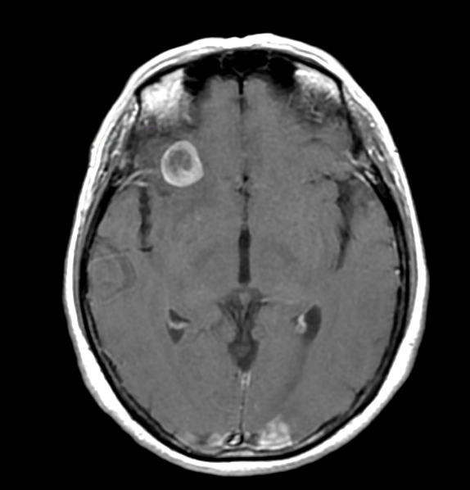
CNS metastases in patients with NSCLC
Approximately 20% of patients have brain metastases at the time of diagnosis
CNS metastases may be more common in some oncogene-driven lung cancers (e.g. 30% in ALK positive NSCLC)
CNS is often a site of disease progression during therapy
Barnholtz-Sloan et al, JCO 2004; Wardak et al, JCO 2014

Slide 3
Common Therapies for Brain Metastases
Whole Brain Radiation Therapy
Stereotactic radiation therapy
Systemic therapy (chemotherapy, targeted therapy)
No randomized prospective trial in patients with oncogene driven cancers

Slide 4
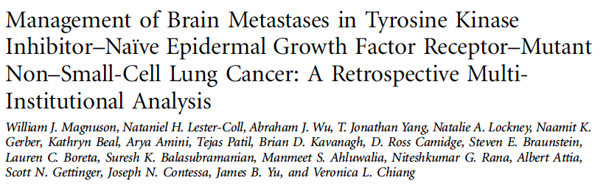
Retrospective analysis of 351 patients
Looked at upfront treatment (no prior EGFR TKI)
Patients treated with EGFR TKI, SRS, or WBRT
JCO 2017

Slide 5
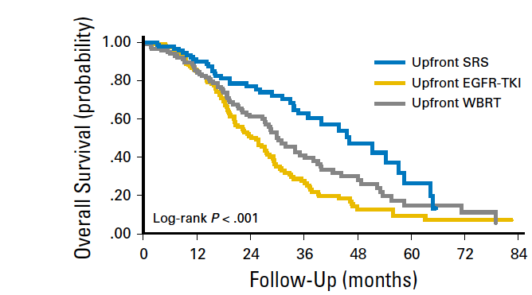
Retrospective Analysis Suggests Better Outcomes with Radiation-based Approaches
Magnuson et al, JCO 2017

Slide 6
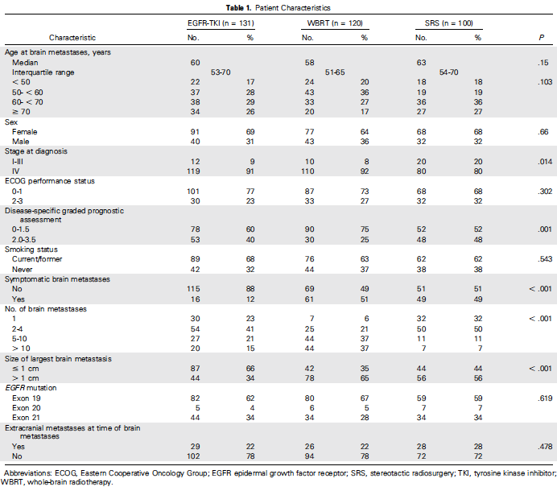
76% (268/351) of patients had no extracranial disease
Not a Representative Population
Magnuson et al, JCO 2017

Slide 7
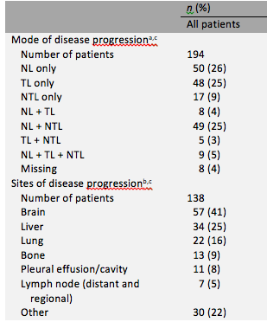
CNS metastases in ALK positive NSCLC
Brain metastases more common at diagnosis
CNS was a common site of progression in initial studies of crizotinib
Very low concentrations of crizotinib in CSF
Ou et al, Annals of Oncology 2014; Costa et al, JCO 2011

Slide 8
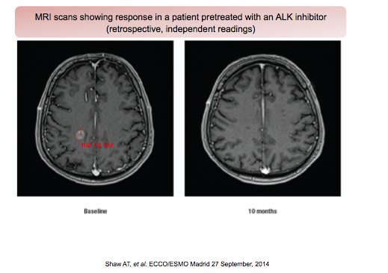
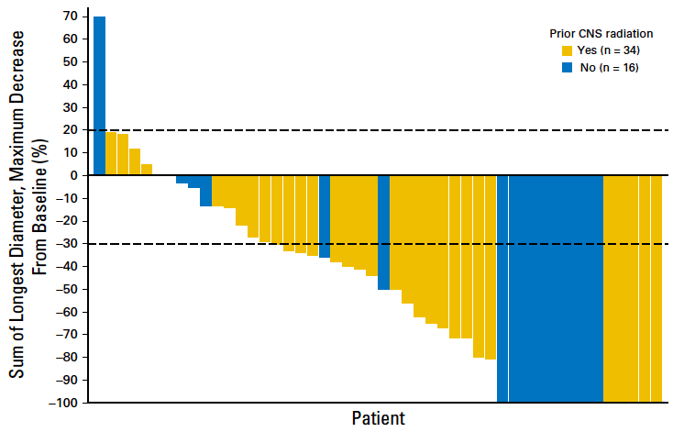
Next generation ALK inhibitors better in the CNS
Ceritinib efficacy in CNS
Alectinib efficacy in CNS
Gadgeel et al, JCO 2016

Slide 9
Crizotinib vs Alectinib in ALK positive NSCLC
Alectinib 600 mg BID PO
KEY ELIGIBILITY
ALK+ by central IHC testing
Advanced or metastatic ALK+ NSCLC
Treatment-naïve
ECOG PS 0−2
Measurable disease
Asymptomatic brain metastases allowed
R A N D O M I Z E
Crizotinib
250 mg BID PO
Peters et al, NEJM 2017

Slide 10
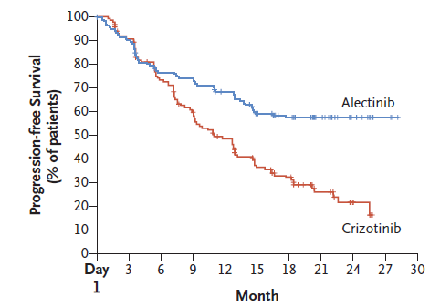
Crizotinib vs Alectinib in ALK positive NSCLC
Peters et al, NEJM 2017

Slide 11
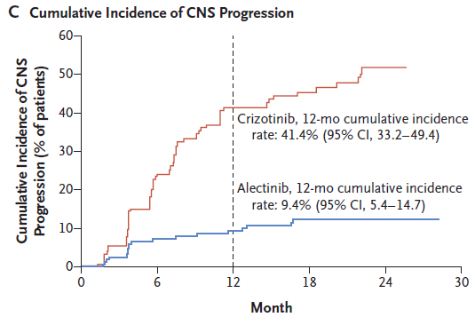
Alectinib Superior to Crizotinib in CNS
Peters et al, NEJM 2017

Slide 12
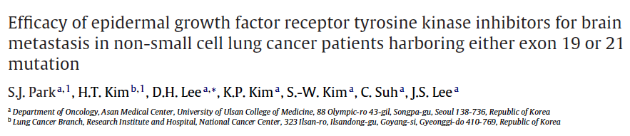
EGFR TKI also have Efficacy in CNS
Enrolled patients with brain metastases and EGFR mutations
83% response rate to EGFR TKI
But, CNS was primary site of disease progression
Lung Cancer 2012

Slide 13
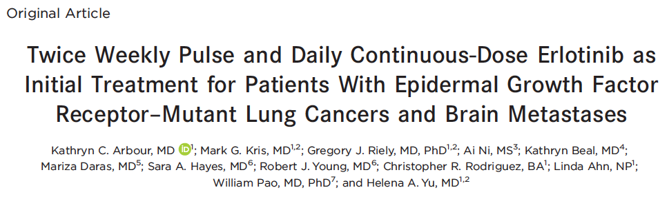
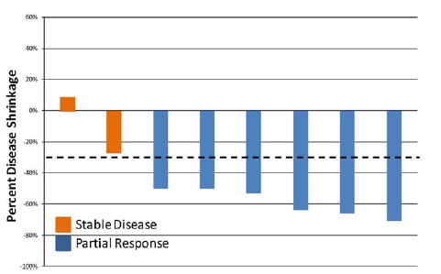
Alternate Dosing Strategies May Have Value
CNS Best Response
Arbour et al, Cancer 2018

Slide 14
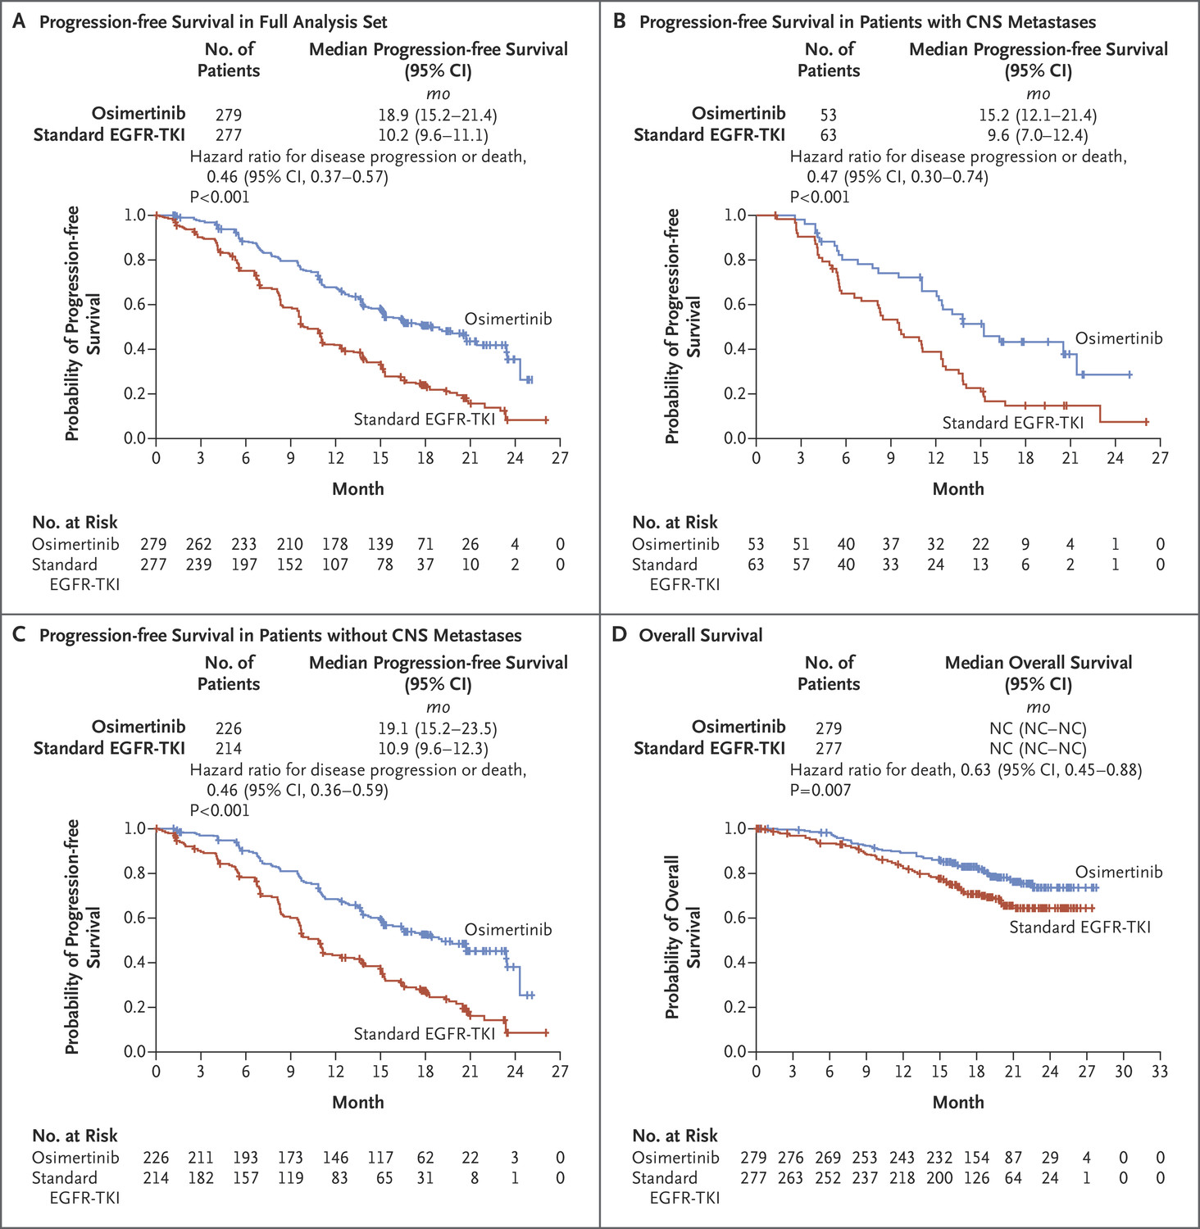
Osimertinib may have superior CNS efficacy compared with erlotinib/gefitinib
Patients with CNS metastases
HR 0.47
Patients without CNS metastases
HR 0.46
Soria et al, NEJM 2017

Slide 15
Treatment of CNS Disease in Patients with Oncogene-Driven Cancers
CNS metastases (Brain metastases and leptomeningeal disease) are common in oncogene driven cancers
No prospective, randomized trials dedicated to exploring modality of therapy (RT vs systemic therapy)
Newer TKIs generally have superior CNS efficacy (equivalent to systemic efficacy)

Slide 16
Case
62 year old woman presents with cough. Chest imaging shows numerous bilateral lung lesions. Biopsy of lung disease shows TTF-1 positive adenocarcinoma. She is found to have an EGFR L858R mutation.
At initial presentation also has some difficulty with headache and balance. MRI showed numerous brain metastases. The largest lesion is 1.4 cm.

Slide 17
What is your initial treatment for this 62 year old woman with metastatic EGFR mutant NSCLC with significant burden of brain metastases?
Whole Brain Radiation Therapy
Erlotinib
Osimertinib
Stereotactic Radiation Therapy

Slide 18
After initial treatment with EGFR TKI, this patient has radiographic response, but 4 months later has progression of disease in the chest, with increased cough. CNS disease has not progressed. What is your next therapy?
Carboplatin/pemetrexed/pembrolizumab
Carboplatin/pemetrexed/bevacizumab
Whole brain radiation therapy
Nivolumab

